Slide 1
Advances developing ad-hoc MSE for Sole in divisions 8.c and 9.a
Marta Cousido-Rocha, Maria Grazia Pennino, Santiago Cerviño
Instituto Español de Oceanografía (IEO, CSIC)
Wgbie, 29–08 April-May 2024
Notes:
The aim of this talk is not to present the initial results of our MSE, the idea is to focus on discussing the crucial decisisons that we need to take and related open questions.

Slide 2
Table of contents
2. Material and methods
1. Introduction
3. Analysis of potencial stock status indicators
4. First catch rule proposal
5. Interesting points!
Notes:
Outline.

Slide 3




1. Introduction
$A_{y+1}=$ $C_{y−1 }×r×f×b×m$
Common sole stock (Solea solea) in ICES Subdivisions 8.c and 9.a is actually in category 3 and the catch advice is derived using the rfb rule (method 2.1 in ICES, 2022¹)
where the advised catch for next year $A_{y+1}$ is based on the most recent year’s observed catch $C_{y−1 }$ adjusted by the following components:
$$r=\frac{\sum_{i=y−2}^{y−1}{{(I}_{i}/2)}}{\sum_{i=y−5}^{y−3}{{(I}_{i}/3)}}$$
$$f=\frac{{\overline{L}}_{y−1}}{L_{F=M}}$$
$$b=min\left\{1, \frac{I_{y−1}}{I_{trigger}}\right\}$$
being $I_{i}$ the biomass index, ${\overline{L}}_{y−1}$ the mean catch length above the length of first capture ($L_{c})$ and $L_{F=M}$a theoretical MSY reference length, and $I_{trigger}$=1.4 $I_{loss}$, where $I_{loss}$ is the lowest observed biomass index value.
¹ ICES. (2022). ICES technical guidance for harvest control rules and stock assessments for stocks in categories 2 and 3. In Report of ICES Advisory Committee, 2022. ICES Advice 2022, Section 16.4.11
Notes:
The m component is set at 0.9 since this is the recommended value for medium-lived stocks with k in 0.2, 0.32 as the common sole. Finally, it is important to mention that, when b1 a stability clause limiting the catch advised change to +20% and -30% of the previous catch advice is applied.

Slide 4
The rfb rule was first applied to advise common sole 8c.9a catches in 2021 by the Working Group for the Bay of Biscay and the Iberian Waters Ecoregion (WGBIE 2021).
Catches should not exceed 209 tonnes for each of the years 2024 and 2025, leading to a 35% reduction from the 2023 catch advice of 320 tonnes.
Component | 2021 | 2023
r | 0.90 | 0.85
m | 0.90 | 0.90
f | 1.03 | 1.04
b | 0.91 | 0.82
WGBIE 2021
WGBIE 2023
Catches should not exceed 320 tonnes for each of the years 2022 and 2023, leading to a 36% reduction from the 2021 catch advice of 502 tonnes.
Length-Based Indicators (LBI), the Length-Based Spawning Potential Ratio (LBSPR) and the mean length-based mortality estimators (MLZ) yielded results that are in accordance with a sustainable exploitation of the stock.

Slide 5
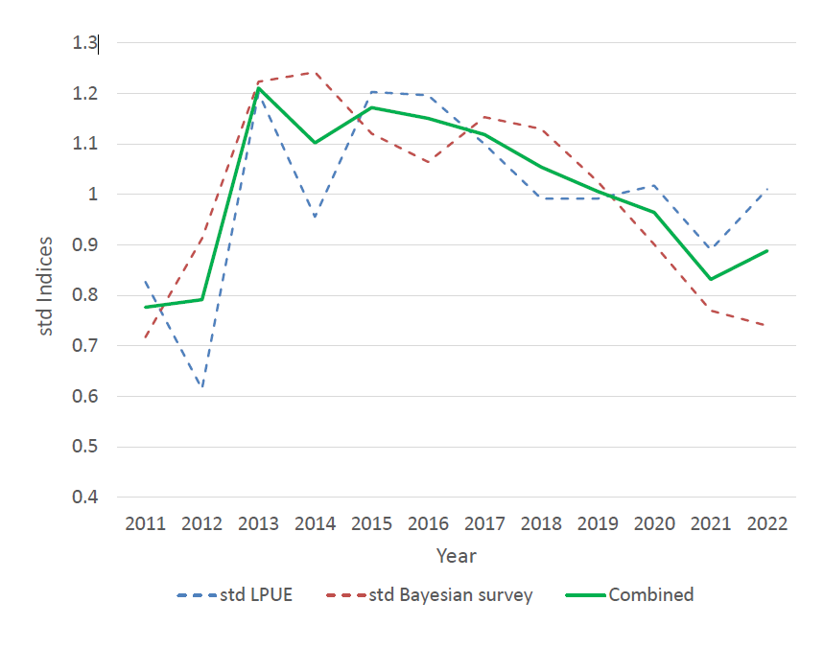
The decreasing trend in the combined index since 2013 aligns with the r and b values.
The index has decreased by 7% (percentage of difference between the 2020 and 2022 values).
The advised catch has been reduced from 502 to 209 tonnes, corresponding to a 58% decrease.

Slide 6
The decreasing trend in the combined index since 2013 aligns with the r and b values.
The index has decreased by 6.7% (percentage of difference between the 2021 and 2022 values).
The advised catch has been reduced from 502 to 209 tonnes, corresponding to a 58% decrease.
The aim is to propose a new catch rule that may better suit the common sole.

Slide 7
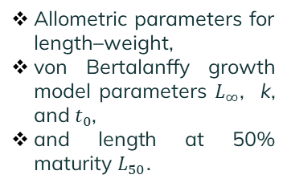
2. Material and methods
Combination of the approaches and codes presented by Fisher et al. (2020) and Fisher et al. (2021) for providing a biomass index and length frequency distributions.
Catch rule calculation and stock projection
OMs
Sampling
Allometric parameters for length–weight,
von Bertalanffy growth model parameters $L_{∞}$, k, and $t_{0}$,
and length at 50% maturity $L_{50}$.
We use the Fisheries Library in R (FLR) software and the FLR package FLife for simulating stocks based on life-history parameters (Fisher et al. 2020).
Based on Fisher et al. (2021) code and mse FLR package.
¹Fischer, S. H., De Oliveira, J. A. A., and Kell, L. T. (2020). Linking the performance of a data-limited empirical catch rule to life-history traits. ICES Journal of Marine Science, 77(5), 1914–1926.
²Fischer, S. H., De Oliveira, J. A. A., Mumford, J. D., and Kell, L. T. (2021). Application of explicit precautionary principles in data-limited fisheries management. ICES Journal of Marine Science, 78(8), 2931–2942.
Notes:
allometric parameters for length–weight, a and b relationship, von Bertalanffy growth model parameters L, k, and t0 , and length at 50% maturity L50.

Slide 8
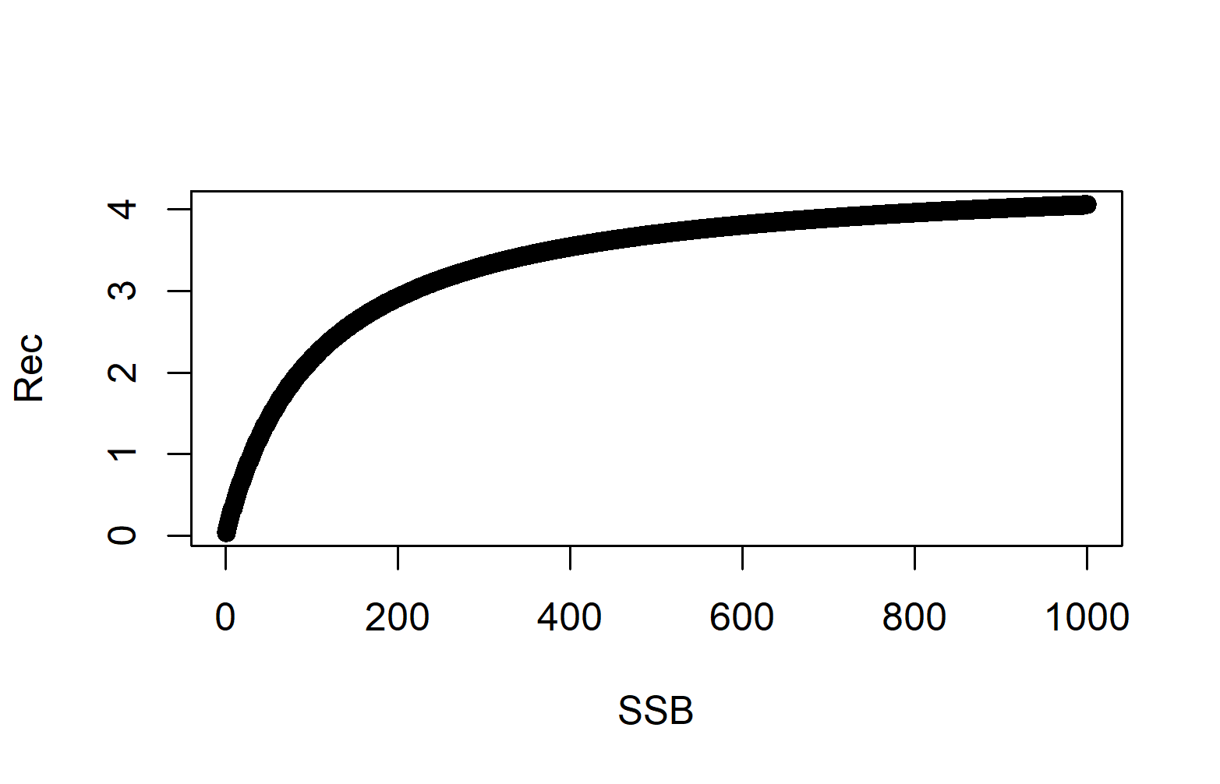
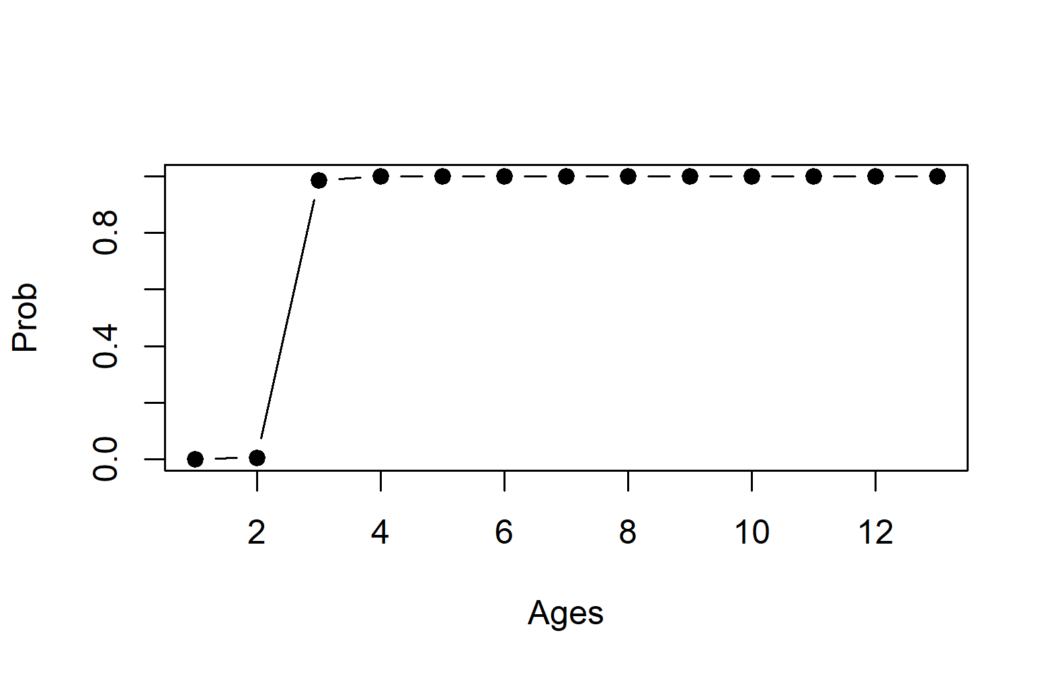

2. Material and methods
OMs
Recruitment by a Beverton–Holt stock recruit function.
Virgin SSB set to 1000 (units).
Maturity modelled with a sigmoid function centered on $a_{50} ($age at 50% maturity).
Fisheries selectivity modelled as logistic.
The age range for computing fbar has been set to 2-9, based on the overall length frequency distribution (LFD) computed from common sole commercial catches from 2011–2021.

Slide 9
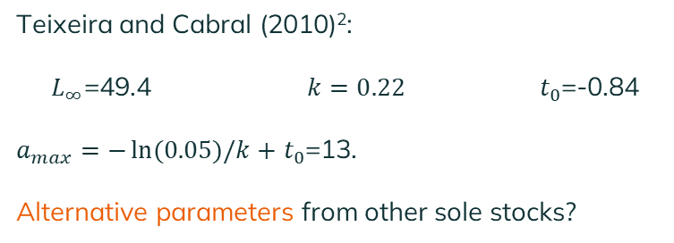
3. Operating Models
Analysis of recruitment variability in ICES data-rich sole stocks.
CVs 0.36 for the 20th percentile, 0.43 for the median, and 0.78 for the 80th percentile.
Recruitment variability
Steepness of the Beverton-Holt model
Steepness based on Myers (2011)¹: 0.72 (20th percentile), 0.84 (median), and 0.91 (80th percentile).
Teixeira and Cabral (2010)²:
${ L}_{∞}$=49.4 $k=0.22 t_{0}$=-0.84
$a_{max}=−\ln{(0.05)/k+}$ $t_{0}$=13.
Alternative parameters from other sole stocks?
Growth through von Bertalanffy parameters
¹Myers, R. A., Bowen, K. G., and Barrowman, N. J. (2011). Maximum reproductive rate of fish at low population sizes. Canadian Journal of Fisheries and Aquatic Sciences, 56(12), 2404-2419.
²Teixeira, C. M., and Cabral, H. N., (2010). Comparative analysis of the diet, growth and reproduction of the soles, Solea solea and Solea senegalensis, occurring in sympatry along the Portuguese coast. Marine Biological Association of the United Kingdom. Journal of the Marine Biological Association of the United Kingdom, 90(5), 995.
Notes:
Título: Variabilidad en el Reclutamiento en Nuestro Marco de MSE
Contenido:
En nuestro marco de MSE (Evaluación de Estrategia de Manejo), la fuente de estocasticidad en el Modelo Operativo (OM) proviene de la variabilidad en el reclutamiento.
Por lo tanto, la selección de valores adecuados para el coeficiente de variabilidad (CV) en el reclutamiento se convierte en una consideración crucial en la definición de los OMs.
Realizamos un análisis de la variabilidad en las estimaciones de reclutamiento de las poblaciones ricas en datos de la ICES.
Calculamos el CV asociado a las series temporales de reclutamiento de las siguientes poblaciones de lenguado: sol.27.20-24, sol.27.4, sol.27.7a, sol.27.7d, sol.27.7e, sol.27.7fg y sol.27.8ab.
Resumimos los CV mediante la mediana, el percentil 20 y el percentil 80, proporcionando valores extremos tanto en el extremo inferior como en el superior, con la mediana representando un valor plausible para la variabilidad en el reclutamiento.
Los valores obtenidos y, por lo tanto, considerados en la definición del conjunto de OMs, son los siguientes: 0.36 para el percentil 20, 0.43 para la mediana y 0.78 para el percentil 80.

Slide 10
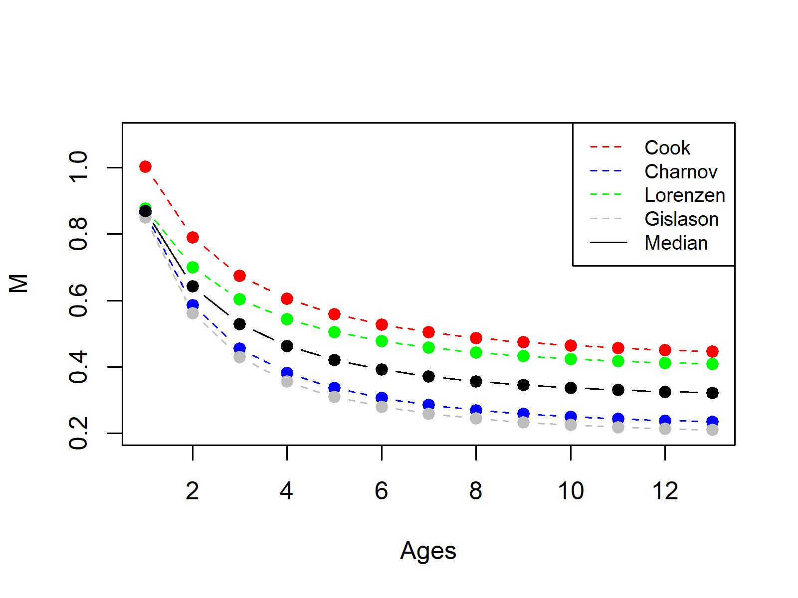
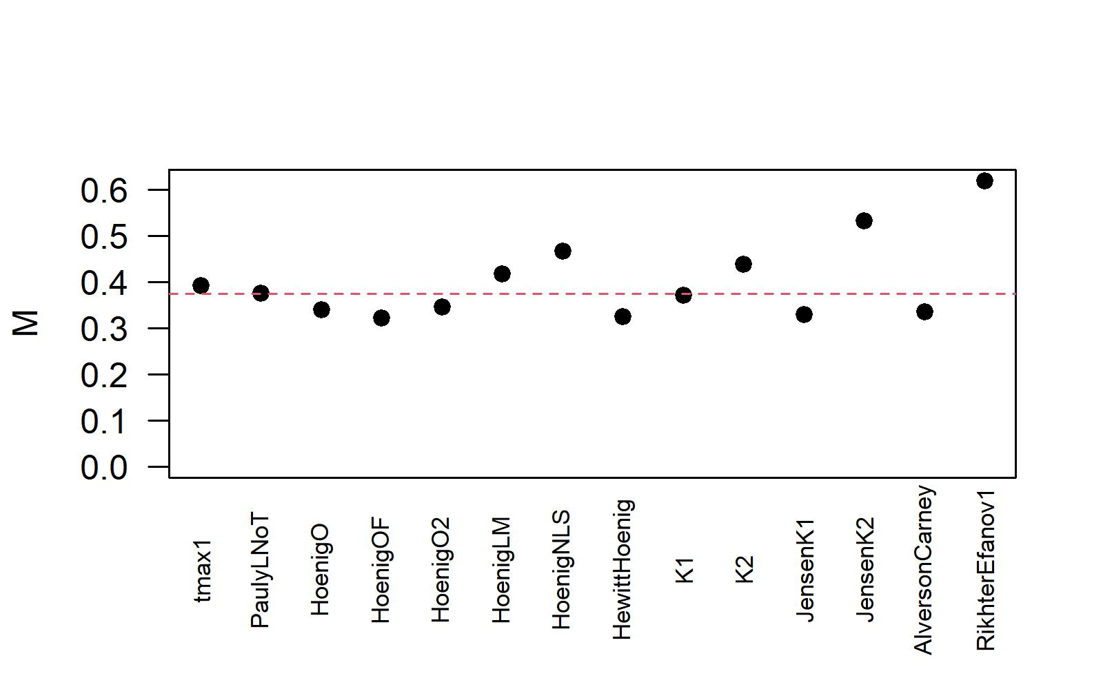


3. Operating Models
Natural Mortality
Sole in ICES divisions 8c and 9a$M=0.31$
Scenario 1: $Constant M=0.3743$
Scenario 2: $M$ at age (age median 0.37)
Notes:
These methods calculate M based on von Bertalanffy parameters, maximum age, or the age at which half the fish in the population become mature (a50).

Slide 11
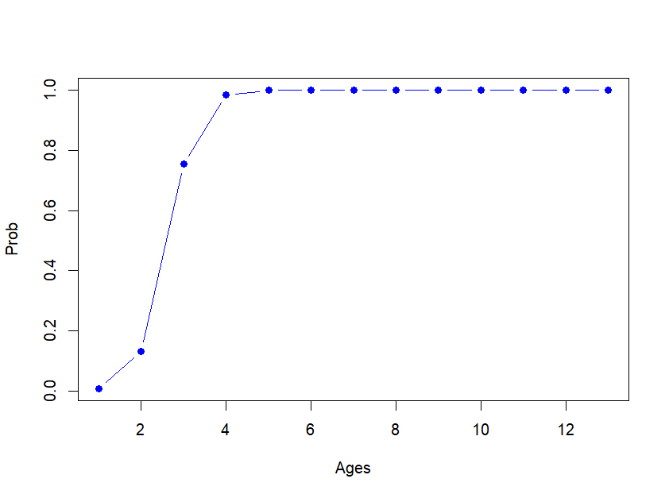

4. Sampling process
$$I_{y}=\left(\sum_{t=1}^{a_{max}}{s_{t}N_{t,y}W_{t,y}}\right)×e_{y}$$
being $N_{t,y}$the population number at age t and year y, $W_{t,y}$ the population weight at age t and year y, $e_{y}$ is the log-normal error term derived from a log-normal distribution centered in one with $σ_{I}$=0.2, and finally $s_{t}$ is the selectivity.
Index of relative biomass
Based on minimum and maximum observed lengths

Slide 12
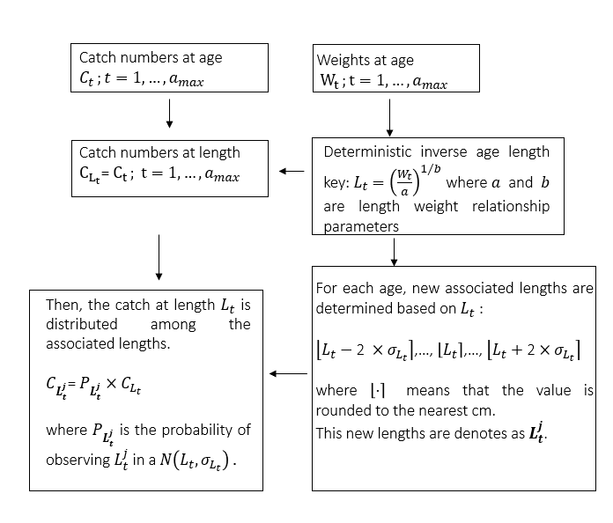
4. Sampling process
Length frequency distributions

Slide 13
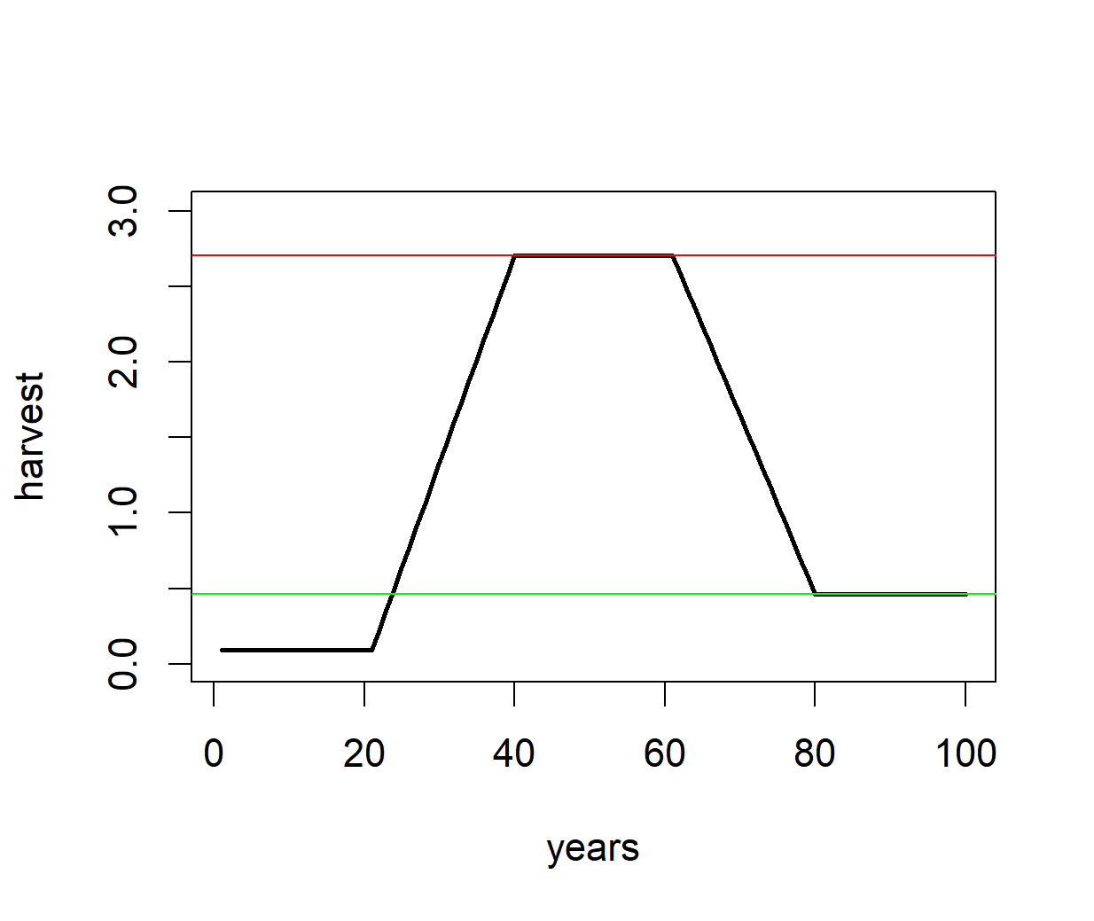
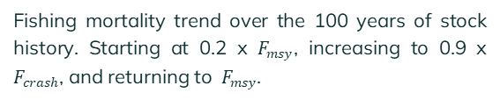

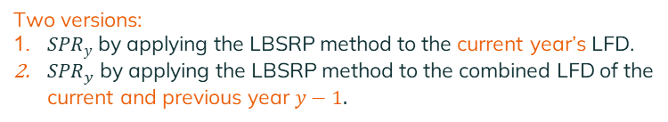


3. Analysis of potencial stock status indicators
'2-over-3’ , '1-over-4' and '1-over-3' versions of the $r$ component.
$f=\frac{{\overline{L}}_{y−1}}{L_{F=M}}$
The ratio of spawning potential ratio estimate (${SPR}_{y−1}$) to a MSY SPR proxy.
Two versions:
${SPR}_{y}$ by applying the LBSRP method to the current year’s LFD.
${SPR}_{y}$ by applying the LBSRP method to the combined LFD of the current and previous year $y−1.$
Fishing mortality trend over the 100 years of stock history. Starting at 0.2 x $F_{msy}$, increasing to 0.9 x $F_{crash}$, and returning to $F_{msy}$.

Slide 14
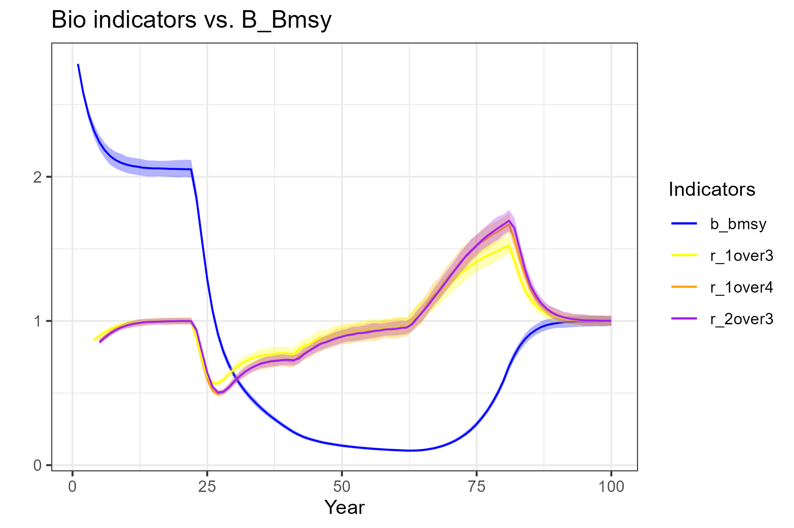

3. Analysis of potencial stock status indicators
The three indicators correctly capture the changes in the biomass trend and that there are no clear differences between them.
Indicators respond correctly to the increase of uncertainty in recruitment or to the inclusion of noise in the relative biomass index.
$B/B_{msy}$ trend and the '2 over 3', '1 over 4' and '1 over 3' versions of the $r$ component.

Slide 15
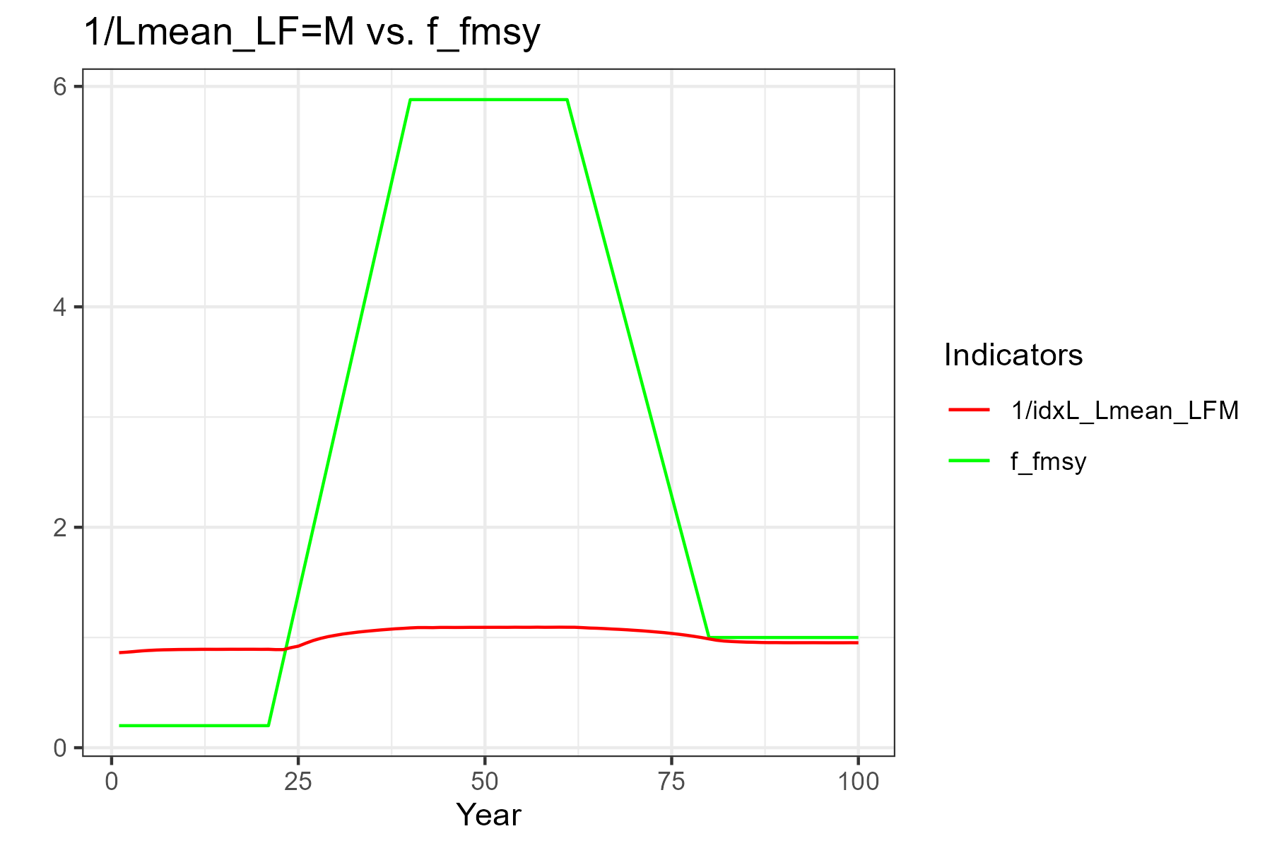

3. Analysis of potencial stock status indicators
The indicator is effective in detecting shifts in fishing mortality trends, but it's important to recognize that its drawback is that its value does not adequately reflect the magnitude of fishing mortality change.
A higher coefficient of variation in the length frequency distribution or in the recruitment does not translate into a higher uncertainty in the indicator.
Indicator ${\overline{L}}_{y−1}$/$L_{F=M}$ (red line) plotted with the relative fishing mortality time series (green line)

Slide 16
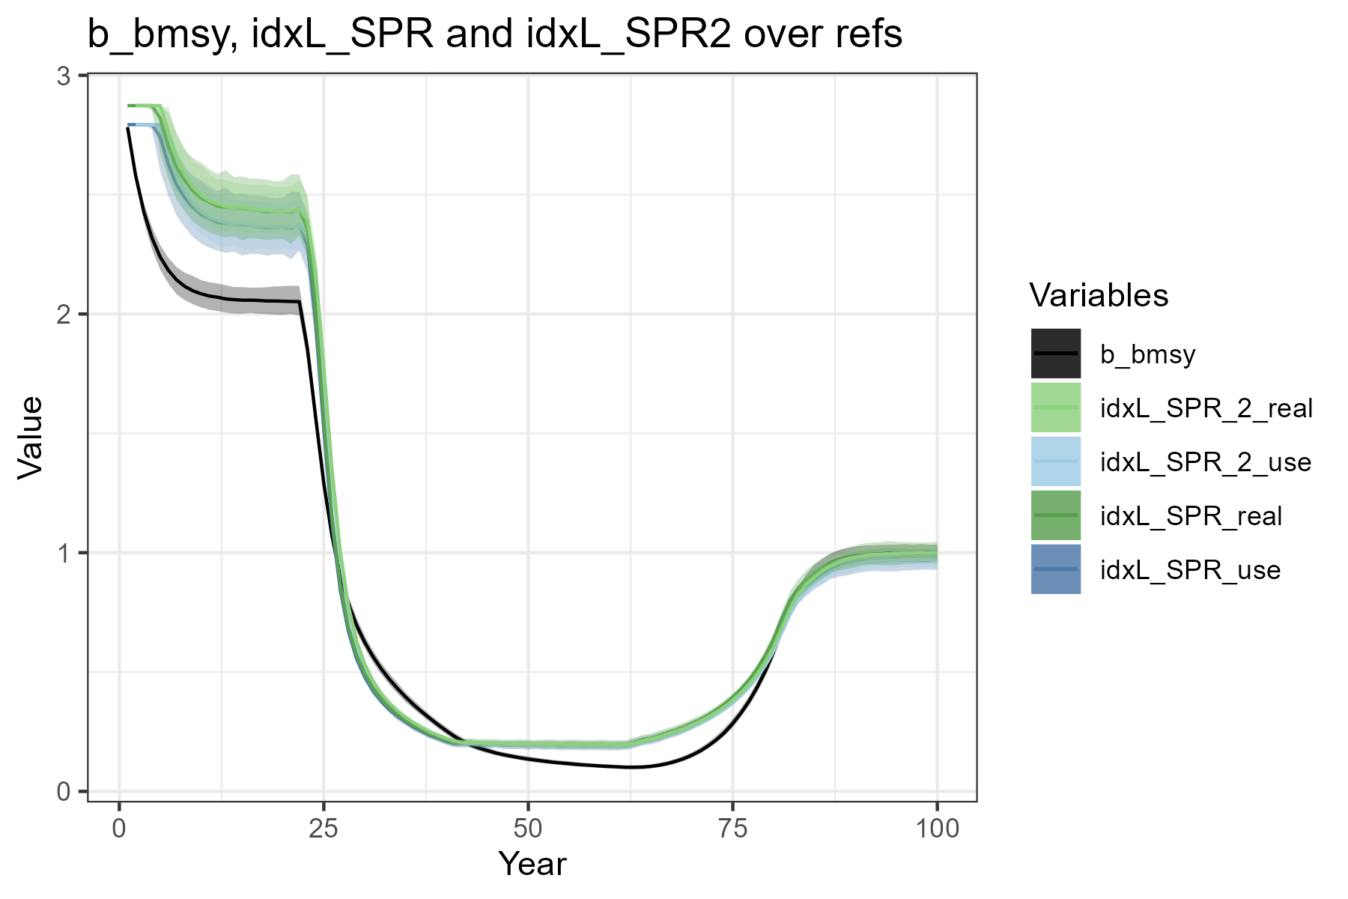


3. Analysis of potencial stock status indicators
The indicators correctly track the trend changes in $B/B_{msy}$, and how the magnitude of the change in our SPR indicators adequately represents the magnitude of the change in $B/B_{msy}$.
Indicators respond correctly to the increase of uncertainty in recruitment or to the inclusion of noise in the LFDs.
Relative biomass time series ($B/B_{msy}$) with the two versions of the SPR indicators.
Note: “use” indicates that the MSY SPR proxy is set to the value that we propose to use in practice, i.e. 0.358.

Slide 17
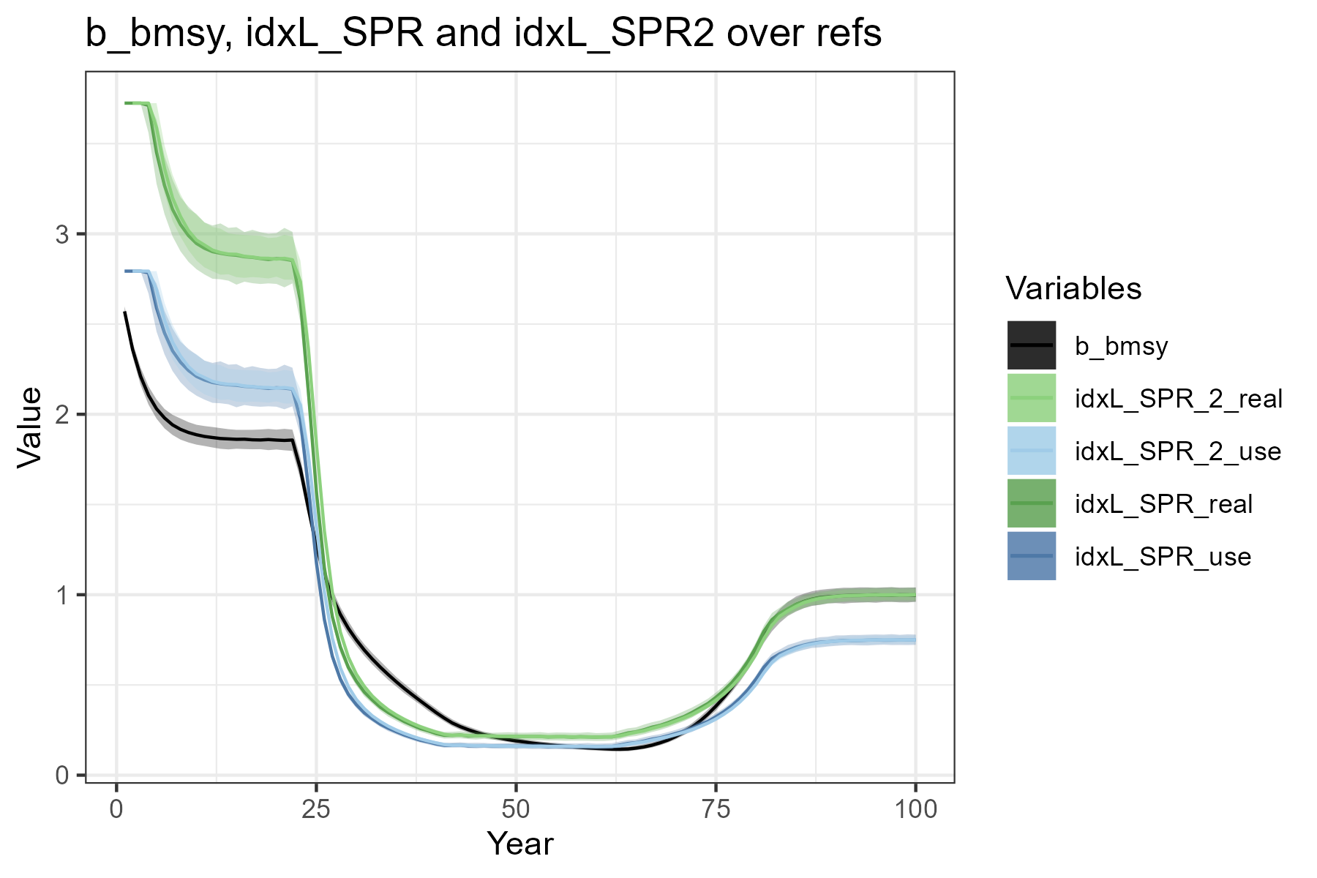

3. Analysis of potencial stock status indicators
Different performance between the “use” and “real” options.
Relative biomass time series ($B/B_{msy}$) with the two versions of the SPR indicators.

Slide 18
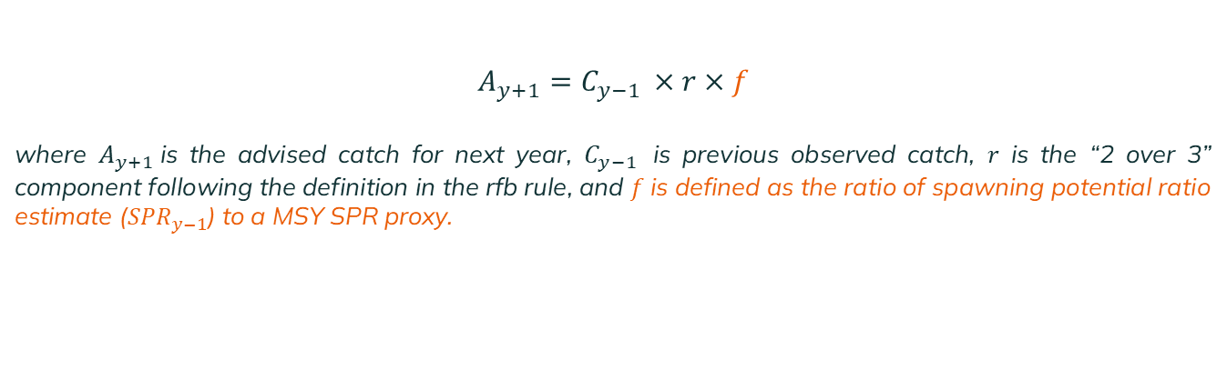
4. First catch rule proposal
$A_{y+1}=$ $C_{y−1 }×r×f$
where $A_{y+1}$is the advised catch for next year, $C_{y−1 }$ is previous observed catch, $r$ is the “2 over 3” component following the definition in the rfb rule, and $f$is defined as the ratio of spawning potential ratio estimate (${SPR}_{y−1}$) to a MSY SPR proxy.
Warning! decision for years y+1 and y+2 (in the case of biannual TACs, as in the case of sole) using information from year y-1 in the f component and from years y-1 to y-5 in the r component.

Slide 19
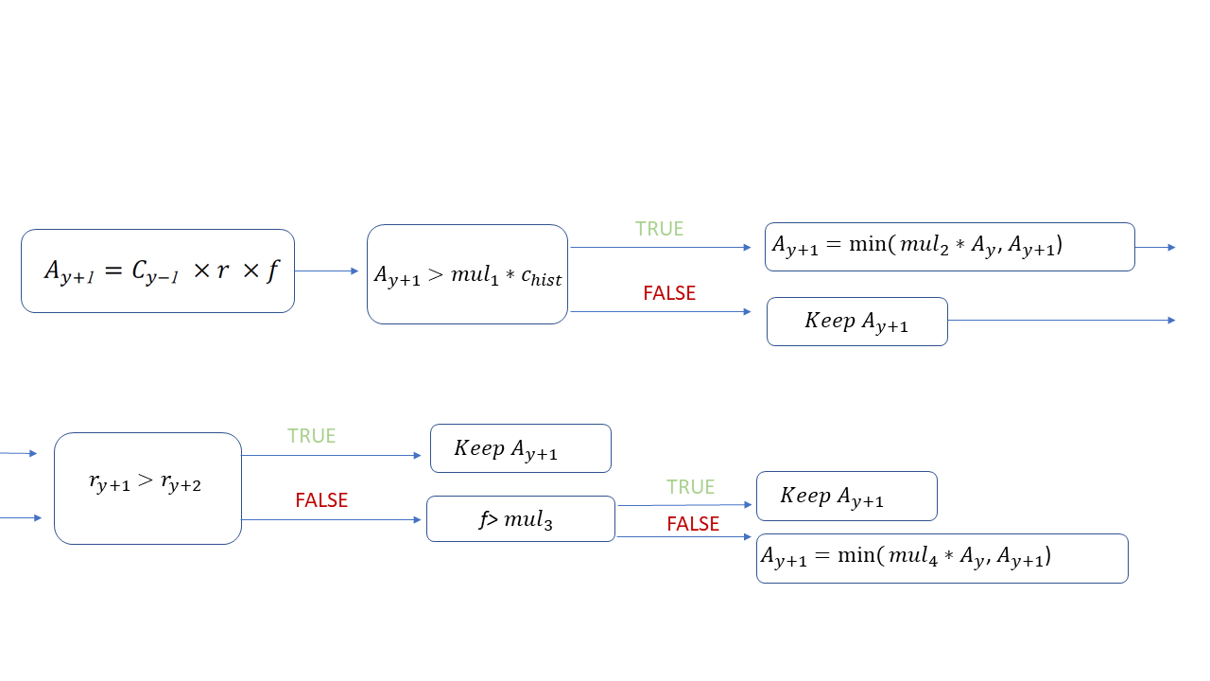
4. First catch rule proposal

Slide 20
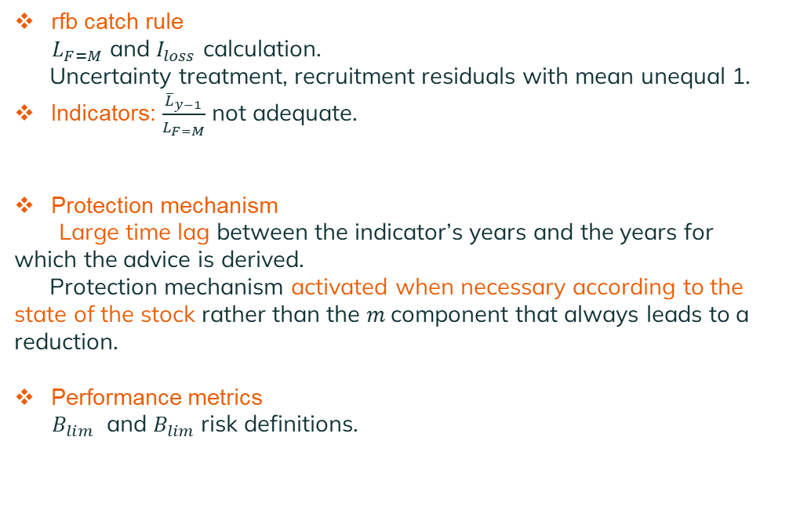
Interesting points!
rfb catch rule
$L_{F=M}$ and $I_{loss}$ calculation.
Uncertainty treatment, recruitment residuals with mean unequal 1.
Indicators: $\frac{{\overline{L}}_{y−1}}{L_{F=M}}$ not adequate.
Protection mechanism
Large time lag between the indicator’s years and the years for which the advice is derived.
Protection mechanism activated when necessary according to the state of the stock rather than the $m$component that always leads to a reduction.
Performance metrics
$B_{lim}$ and $B_{lim}$risk definitions.

Slide 21





Thanks for your attention!
Instituto Español de Oceanografía (IEO, CSIC).
Centro Oceanográfico de Vigo.
Subida a Radio Faro, 50-52, 36390, Vigo, Pontevedra, Spain.
marta.cousido@ieo.csic.es
@CousidoMarta; @MERVEXgroup_IEO

Slide 22
Thanks for your attention!
Funding sources
MAP2021-06. Componente 3. Inversión 7. CONVENIO ENTRE EL MINISTERIO DE AGRICULTURA, PESCA, Y ALIMENTACIÓN Y LA AGENCIA ESTATAL CONSEJO SUPERIOR DE INVESTIGACIONES CIENTÍFICAS M.P. -A TRAVÉS DEL INSTITUTO ESPAÑOL DE OCEANOGRAFÍA- PARA IMPULSAR LA INVESTIGACIÓN PESQUERA COMO BASE PARA LA GESTIÓN PESQUERA SOSTENIBLE. Math4Fish: Nuevas herramientas para el modelado matemático en el asesoramiento científico de pesquerías españolas. Ministerio de agricultura, pesca y alimentación. European Union-Next Generation EU.

